Slide 1
Provider System
Changes
August 2019 Training for Scheduling Companies

Slide 2
Move to TXCOMP
New system for health care providers and designated doctors:
TXCOMP Claims and Coverage system (TXCOMP).
What’s changing?
    New password requirements
    Allows designated doctors to add a scheduling company or an administrator to manage their profile
Why is it changing? The division is consolidating and modernizing its two main enterprise systems.
When is it changing? Monday, August 19, 2019.

Slide 3
Move to TXCOMP
How does this affect me?
  Scheduling companies must submit the DWC Form-120, Designation of Administrative Services Company Administrator to be added to the system.
  All users with existing access to the Provider system will have access to TXCOMP.
  Update your bookmarks to the new web site:
    https://appscenter.tdi.texas.gov/TXCOMPWeb/common/home.jsp
  There is no impact to the designated doctor appointment offer process.

Slide 4
TXCOMP Passwords
On August 19, the system will require a new password format.
  Minimum of 10 characters that must include:
      Uppercase letter (A through Z)
      Lowercase letter (a through z)
      Numeral (0 through 9)
      Special character (such as !, $, #, %)

Slide 5
New!
Currently, doctors can only associate one administrator to manage their profile.
In the new system, doctors can choose an administrator or a company to manage their profile.
The company can give their employees access to manage the doctor’s profiles.

Slide 6
Designated Doctor Agent Relationships
NEW!

Slide 7
TXCOMP Terminology
A few system terms:
People are called Individuals.
Companies are called Organizations.
Scheduling companies and doctor admins are called Agents.
The system assigns a Customer ID to each individual and organization. It’s located at the top of the profile page.

Slide 8
Designated Doctor Agents
The Doctor Administrator role:
  Designated doctors can assign either a person (individual) or a company (organization) to manage their online profile, including examination locations.
  If the designated doctor selects an organization to act as their agent, all approved staff associated with that organization can manage the doctor’s profile.
  A designated doctor can still only have one agent (individual or organization) at a time.

Slide 9
New TXCOMP Roles
Two new system roles allow the doctor’s scheduling company to manage appointment coordination for designated doctors:
  Doctor Agent Administrator approves other employee’s access to the company profile and designated doctor information and can manage designated doctor exam locations.
  Doctor Agent Employee manages designated doctor exam locations.

Slide 10
Doctor: Agent Selection
If the agent isn’t found in the system:
  Person (individual): submit an Online Access Request form at:
  https://appscenter.tdi.texas.gov/TXCOMPWeb/common/home.jsp
  Company (organization): submit the DWC Form-120, Designation of Administrative Services Company Administrator to DWC.
    https://www.tdi.texas.gov/forms/form20numeric.html
  This no change to existing features for individual agents.

Slide 11
Establishing a Company Profile
1. Agent submits
DWC Form-120, Designation of Administrative Services Company Administrator 
2. DWC establishes
the company’s organization profile.
3. Administrators
request TXCOMP access.
4. DWC approves
the administrator’s affiliation to the company.
5. Other company employees may request TXCOMP access.
6. Administrators approve
all other employees.
Maximum of 3 administrators. The form is required every time an administrator needs to be added or removed from the company’s profile.

Slide 12
Doctor Agent Administrator Activities

Slide 13
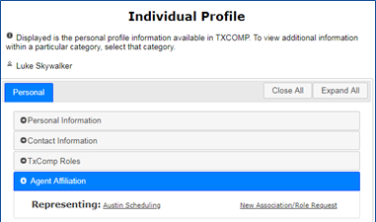
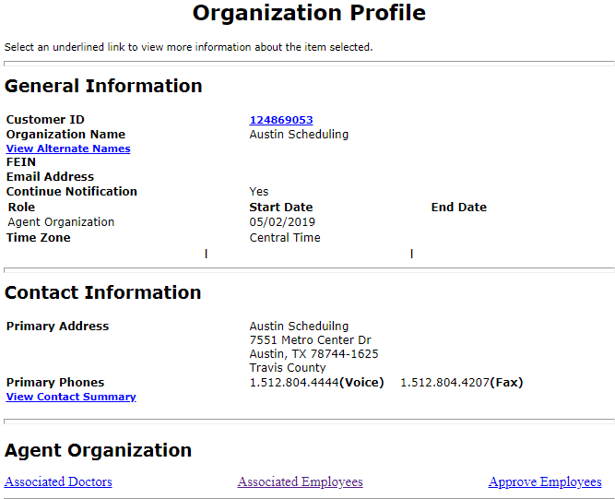
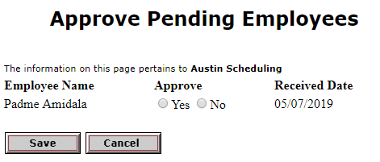
Agent Administrator: Approve Employees
1
2
From the administrator’s profile, expand the Agent Affiliation section.
Select the Organization Name link.
On the Organization Profile page, select the Approve Employees link.
On the Approve Pending Employees page, select the Yes button.
Click Save to save the employee’s association to the company.
3
4
5

Slide 14
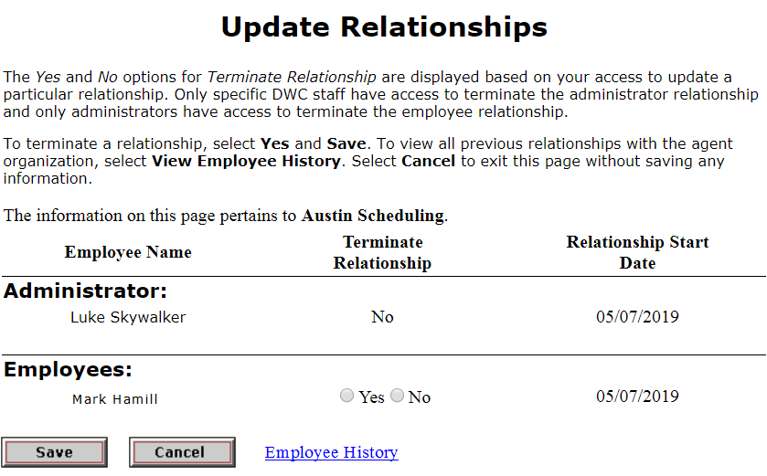
Agent Administrator: Manage Employees
Terminate employee relationship
From the Organization Profile page, select the Associated Employees link.
On the Update Relationships page, select Yes in the Terminate Relationship column.
Click Save.
Select the Employee History link to view a history of all employees previously associated to the company.
Note: the Administrator section of Update Relationships page is view only.
1
View only
2
3
4

Slide 15
Doctor Agent Admin & Employee Activities

Slide 16
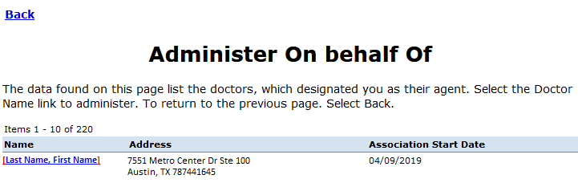
Agent Organization: Access Doctor Profile
From the Organization Profile page, select the Associated Doctors link to view of list of doctors.
On the Administer on behalf of page, select a doctor Name link to access the doctor’s Individual Profile.
1
2

Slide 17
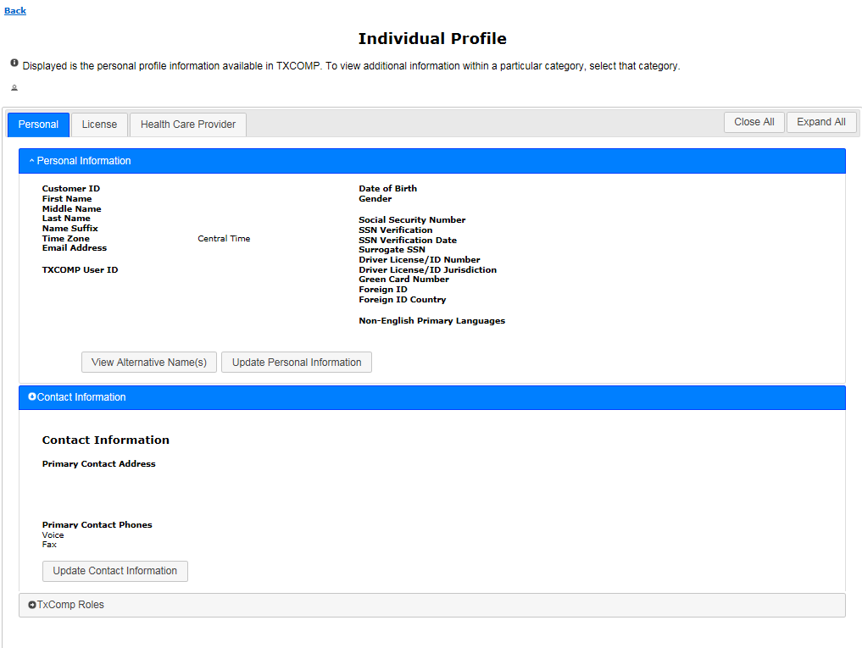
Doctor’s Individual Profile Layout
NEW!
Tabs now organize information

Slide 18
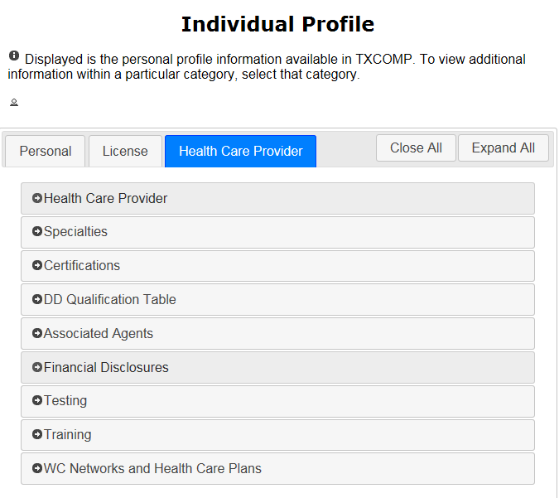
Doctor’s Individual Profile Layout
NEW!
NEW!
Sections expand and collapse

Slide 19
How to get help
Need a DWC Form-120, Designation of Administrative Services Company Administrator?
  https://www.tdi.texas.gov/forms/form20numeric.html
Need help with a technical issue or login?
Call the TXCOMP help line: 888-4-TXCOMP (489-2667)
Or send an email to TXCompHelp@tdi.texas.gov:
Describe the actions you were trying to do when issue happened, include a screen shot if possible.

